Slide 1
Model-based Outlier Detection for Object-Relational Data
Fatemeh Riahi
Dec 2016

Slide 2
Outline
Introduction
Outlier Definition
Outlier Detection Challenges
Existing outlier detection methods
Data Model and Datasets
Contribution
Model-based outlier detection
Propositionalization for outlier detection
Model-based outlier detection
Success and Outlierness
Limitation, Future work, Conclusion

Slide 3
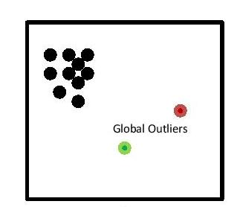

Outlier Definition
Many definition; no generally accepted one.
Observation that are generated by a different mechanism.
Rare graph objects that differ significantly from the majority of reference objects.
Different Types of outlier
Global Outlier
Contextual Outlier
Contextual Attributes
Behavioral Attributes
Collective Outlier
Identification of Outliers, Hawkings, 1998
ODDBALL, Akoglu, 2010

Slide 4
Outlier Detection Challenges
How to model “normality”?
Choosing distance or similarity measure
Noise vs. Outlier
Interpretability
Class Imbalance
Outlier Analysis, Aggarwal, 2013

Slide 5
Categorization of Existing outlier detection work
Outlier Detection in Static Data
Outlier Detection in Dynamic Data
Out of Scope of this Work
Input Format:
Propositional Data
Input Format:
Structured Data
Plain
Attributed
Plain
Attributed
Probabilistic, Generative model-based and Statistic-based Methods
Proximity-based Methods and Feature-based Methods
Community-based
Relational Learning-based

Slide 6
Limitation of Existing Work
Assuming specific distribution.
Lack of interpretability
Higher level of granularity result in inefficiency
Having hard time in high dimensional data

Slide 7

Problem Definition
Most of outlier detection method work have been designed for propositional data.
Information loss when using hand crafted features or aggregation based features.
Avg(ShotEff)=0.45
Avg(Goals)=0.5
PlayerID | MatchID | Venue | Shot_Eff | Goals
1123 | M1 | Home | 0.9 | 1
1123 | M2 | Away | 0 | 0
1123 | M3 | Home | 0.9 | 1
1123 | M4 | Away | 0 | 0
Aggregation
Image is downloaded from :
https://www.dreamstime.com/stock-illustration-business-concept-build-destroy-vector-cartoon-image44176241

Slide 8
Object Relational Data
One of the main data models for structured data is Object-relational data model.
Object Identity; Class Membership; Object Relationships
Object1: Player
Object1 Instance
PlayerID
TeamID
1123
1(ManU)
PlayerID | MatchID | Shot_Eff | Pass_Eff | TimePlayed
1123 | 2 | High | High | Low
1123 | 3 | Low | Low | High
1324 | 21 | Med. | Med. | Low
1324 | 16 | High | Low | Low
Object2: Team
Object2 Instance
TeamID
1
Object2: MatchID
Object2 Instance
MatchID
3

Slide 9
Model-based outlier detection
Advantages of Model-based approach:
Apply statistical relational learning methods to build the model
Leverage statistical concepts such as divergence metric
Employ outlier detection methods designed for the propositional data

Slide 10
Datasets
Anomaly Injection: model is expected to detect the injected data points as outlier.
Anomaly Injection in real world datasets:
In Soccer dataset there are players with different positions; we consider players of a specific position as normal population and inject players of a different position as outliers.
Strikers as normal; Goalies as outlier
Midfielders as normal; Strikers as outlier
In IMDb dataset, there movies with different genres; we consider movies of a specific genre as normal population and inject movies of different genre as outliers.
Drama vs. Comedy

Slide 11
Synthetic Datasets: High Correlation
P(F1=1|F2=1)=0.9
P(F1=0|F2=0)=0.9
P(F1=1)=0.5
High Correlation | F1 | F2
Normal | 1 | 1
 | 1 | 1
 | 0 | 0
 | 0 | 0
Outlier | 1 | 1
 | 1 | 0
 | 0 | 0
 | 0 | 1
Normal
F1
F2
P(F1=1)=0.5
P(F2=1)=0.5
Outlier
F1
F2

Slide 12
Synthetic Datasets: Low Correlation
P(F1=1)=0.5
P(F2=1)=0.5
Low Correlation | F1 | F2
Normal | 1 | 1
 | 1 | 0
 | 0 | 0
 | 0 | 1
Outlier | 1 | 1
 | 1 | 1
 | 0 | 0
 | 0 | 0
Normal
F1
F2
P(F1=1|F2=1)=0.9
P(F1=0|F2=0)=0.9
P(F1=1)=0.5
Outlier
F1
F2

Slide 13
Synthetic Datasets: Single Feature
P(F1=1|F2=1)=0.9
P(F1=0|F2=0)=0.9
P(F1=1)=0.5
Low Correlation | F1 | F2
Normal | 1 | 1
 | 1 | 0
 | 0 | 0
 | 0 | 1
Outlier | 1 | 1
 | 1 | 1
 | 0 | 0
 | 0 | 0
Normal
F1
F2
P(F1=1|F2=1)=0.9
P(F1=0|F2=0)=0.9
P(F1=1)=0.9
Outlier
F1
F2

Slide 14
First Model-based Approach: Propositionalization
*
* Propositionalization for Unsupervised Outlier Detection in Multi-relational data, In the proceeding of Florida Association of Artificial Intelligence, 2016

Slide 15
Propositionalization for Outlier Detection
Transform the object-relational representation of data into a propositional representation.
Construct features that capture relational properties
Define features as conjunction of literals.
Example individuals (e.g. players) are represented as a feature-vectors of fixed size.
Apply propositional outlier detection methods to the constructed table.

Slide 16
How to Construct Features
*
Use a generative model such as MLN
Markov Logic Network is a set where is a formula and is the weight of the formula.
Markov Logic Learning:
Input: A relational database.
Output: A set of conjunctive formulas that describe statistical patterns in the relational data.
We use the moralization method introduced by Khosravi et al.
**
* A Unifying Framework for Statistical Relational Learning, ICML, 2004
**Structure Learning for Markov Logic Network, Khosravi et al. 2010

Slide 17
Feature Extraction and Enumeration
Relational Data tables
Wayne Rooney
Javier Hernandez
ShotEff(P,M)=high
PassEff(P,M)=high
ShotEff(P,M)=high
PassEff(P,M)=high
Learn a set of MLN Formulas or Templates
Match
Result(T,M)=Win
Count number of sub graphs that satisfy the template
Manchester United

Slide 18
Alternative Way to Construct Feature
Wordification: Using the concept of n-grams from NLP:
Unigram: All single literals.
Bigram: All conjunctions of two literals.
TreeLiker, WARMAR and basically any Propositionalization approach
*
*A Wordification Approach to Relational Data Mining, Perovsek et. Al, 2013

Slide 19
Feature Function
A function that aggregates the multiple instantiations to derive a real number that is the value of the attribute.
We can use either term frequency (TF) or term frequency/inverse document frequency (TF-IDF).
We call TF and TF-IDF that map multiple instances of a formula to real values: Feature Functions

Slide 20
Propositional Outlier Detection Method
KNN: Distance-based method
It assigns a score to each data point on the basis of distance of the point from its k nearest neighbor
LOF: Density-based method
It quantify the outlierness of the data points relative to regions of different densities.
OutRank: Subspace-based method
It compares clusters in different subspace to derive an outlier score for each object
*
**
***
* Efficient Algorithms for Mining Outliers from Large Data Sets, Ramaswamy et al., 2000
** Outlier Ranking via Subspace Analysis in Multiple views of Data, Muller et al., 2012
*** LOF: Identifying Density-based Local Outliers, Breunig et al., 2000

Slide 21

System Overview
MLN-Learning
UniGram
BiGram
DB
Formulas
Feature-Function e.g. TF, TF-IDF
KNN LOF OutRank
Pseudo-iid data table
Attribute Vector for Outlier Detection Methods

Slide 22
Example
CP Table
ShotEff(P,M) | PassEff(P,M) | CP | Prior
Low | High | 0.5 | 0.5
Low | Low | 1 | 0.5
High | High | 0.95 | 0.5
ShotEff(P,M) | PassEff(P,m) | CP | Prior
Low | High | 0.5 | 0.5
Low | Low | 1 | 0.5
High | High | 0.95 | 0.5
High | Low | 0 | 0
Smooth CP Table
Extract Formulas
Choose weighting function
Prior Vector
f1 | f2 | f3 | f4
0.5 | 0.5 | 0.5 | 0
KNN
LOF
OutRank
Apply feature function
e.g. TF,TFIDF
CP Vector
f1 | f2 | f3 | f4
0.5 | 1 | 0.95 | 0

Slide 23
Evaluation Metrics
Dimensionality: The number of attributes in the final attribute table
Attribute Complexity: The length of conjunctions that define attributes
Outlier Analysis Run Time
Attribute Construction Time
Apply state-of-the-art outlier detection methods to the attribute table in order to compare the performance of different feature generation methods.
Performance accuracy score: AUC

Slide 24
Evaluation Result
A propositionalization method is scored 1 point if it produces the best accuracy on a dataset, and 0.5 points if it ties. The table shows the total number of wins and average of AUC over all datasets.
Propositional Outlier Detection Method | MLN-TF |  | Bigram-IDF |  | Unigram-TF |  | Treeliker
 | Wins | AVG(AUC) | Wins | AVG(AUC) | Wins | AVG(AUC) | Wins | AVG(AUC)
OutRank | 2.50 | 0.79 | 2.50 | 0.70 | 1.00 | 0.64 | 0 | NA
KNN | 3.50 | 0.78 | 1.50 | 0.67 | 1.50 | 0.67 | 0 | 0.64
LOF | 4.00 | 0.63 | 1.00 | 0.55 | 1.00 | 0.61 | 1 | 0.61

Slide 25
Summary and Future work
Impedance mismatch: Standard outlier methods assume single-table data, but relational databases maintain multiple interrelated tables.
AI-based solution: Discover informative features in the relational database, use them to construct a single-data table.
Efficient conjunctive feature discovery = Markov Logic Network structure learning.
Works better than baselines with isolated attributes (unigrams) or enumerating all binary conjunctions of attributes (bigrams).
More results on comparing with supervised propositionalization (not in paper).
Other ways of generating unsupervised formula: WARMR
Use heuristic (partial) propositionalization instead of complete

Slide 26
Second Model-based Approach: Propositionalization
Model-based Outlier Detection for Object-relational data, in Computation Intelligence, IEEE Symposium Series, 2015
Identifying Important Nodes in Relational Data, AAAI Late Breaking Paper Track, 2013

Slide 27
Model-based Outlier Detection: Loglikelihood distance
How different is an individual from a reference population.
How different is a “Brave Hearth” from a random movie?
Define Outlierness metric based on comparing an individual to a random individual

Slide 28
The Random Selection Pseudo-Likelihood
The generative model represents normal behavior.
If the model assigns a low likelihood to generating an individual outlier.
Could not detect outliers in Single-Feature synthetic dataset.

Slide 29
Feature Divergence
Consider each feature independently.
Feature Outlier: unusual distribution over single attribute in isolation.
Compare DribbleEfficiency distribution in Class and individual data.
Failed to detect outliers in High correlation and low correlation datasets

Slide 30
Kulback-Leibler Divergence
B_{c} models the class database distribution
B_{o} model the individual database distribution D_{o}
The KLD is the individual data log-likelihood ratio:

Slide 31
KLD Performance
KLD performs very good on all three synthetic dataset. Not perfect though.
A problem with KLD: some log ratios are positive, some negative ➔ cancelling of differences
Can fix by taking log-distances
Better but again not perfect.

Slide 32
Mutual Information Decomposition
The interpretability of the metric can be increased by a mutual information decomposition of KLD
KLD wrt marginal single-variable distributions
lift of parent condition in individual distribution
lift of parent condition
in class distribution
The first sum measures single-variable distribution difference
The second sum measures difference in strength of associations

Slide 33


Example of Mutual Information
Confidence=0.50
Support=0.16
Confidence=0.38
Support=0.5
Images are from:
http://spanish.fansshare.com/gallery/photo
http://rexdl.com/android/striker-soccer-america-2015-apk.html/

Slide 34
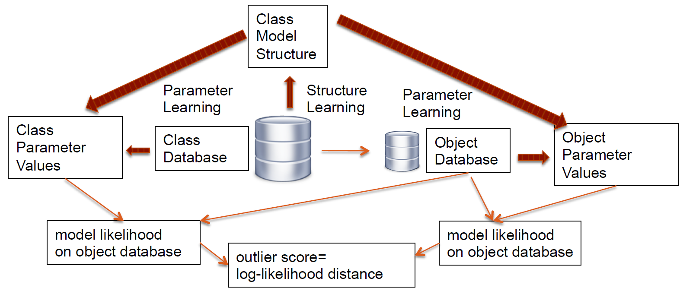
Summary of Approach

Slide 35
Evaluation
Evaluation Metric= AUC; max=1
Dataset | ELD | LOF | OutRank | KNN
High Correlation | 1.00 | 0.68 | 0.99 | 0.97
Low Correlation | 1.00 | 0.58 | 0.83 | 0.97
Single Feature | 1.00 | 0.63 | 0.88 | 0.86
Striker vs Goalie | 0.89 | 0.61 | 0.60 | 0.63
Midfielder vs Striker | 0.66 | 0.76 | 0.71 | 0.58
Drama vs Comedy | 0.70 | 0.51 | 0.68 | 0.68
 | ELD | |LR| | LR | FD | LOG
High Correlation | 1.00 | 0.99 | 0.97 | 0.88 | 0.98
Low Correlation | 1.00 | 0.99 | 0.98 | 0.35 | 0.81
Single Feature | 1.00 | 1.00 | 1.00 | 1.00 | 0.79
Striker vs Goalie | 0.89 | 0.77 | 0.65 | 0.71 | 0.61
Midfielder vs Striker | 0.66 | 0.62 | 0.55 | 0.59 | 0.54
Drama vs Comedy | 0.70 | 0.68 | 0.66 | 0.64 | 0.66

Slide 36
Summary and Future Work
Relational anomaly detection: how different is the feature distribution of an individual from the feature distribution of its class?
Basic idea: compare individual model likelihood of with class model likelihood of class features.
Key point: avoid cancellations in log-likelihood comparison -> use distances, not differences.
Bayesian network model:
computationally feasible
accurate
interpretable

Slide 37
Success and Outlierness

Slide 38
In-class exception
Use ELD metric to compare individuals
How accurate is the ranking?
Compare it with independent ranking metric of the individuals, e.g. salary of players or rating of the movie
What to expect? Both exceptionally good and exceptionally bad individuals will be on top
Learn Class BN for entire population
Compare Individual BN and Class BN
Compute ELD
Rank Individuals Based on ELD

Slide 39
Challenges of Ranking Individuals
We investigate some of the known difficulties of ranking players in our domain:
Team with larger budgets pay higher wages
Players Nationality
Famous players’ salaries are independent of their performance

Slide 40
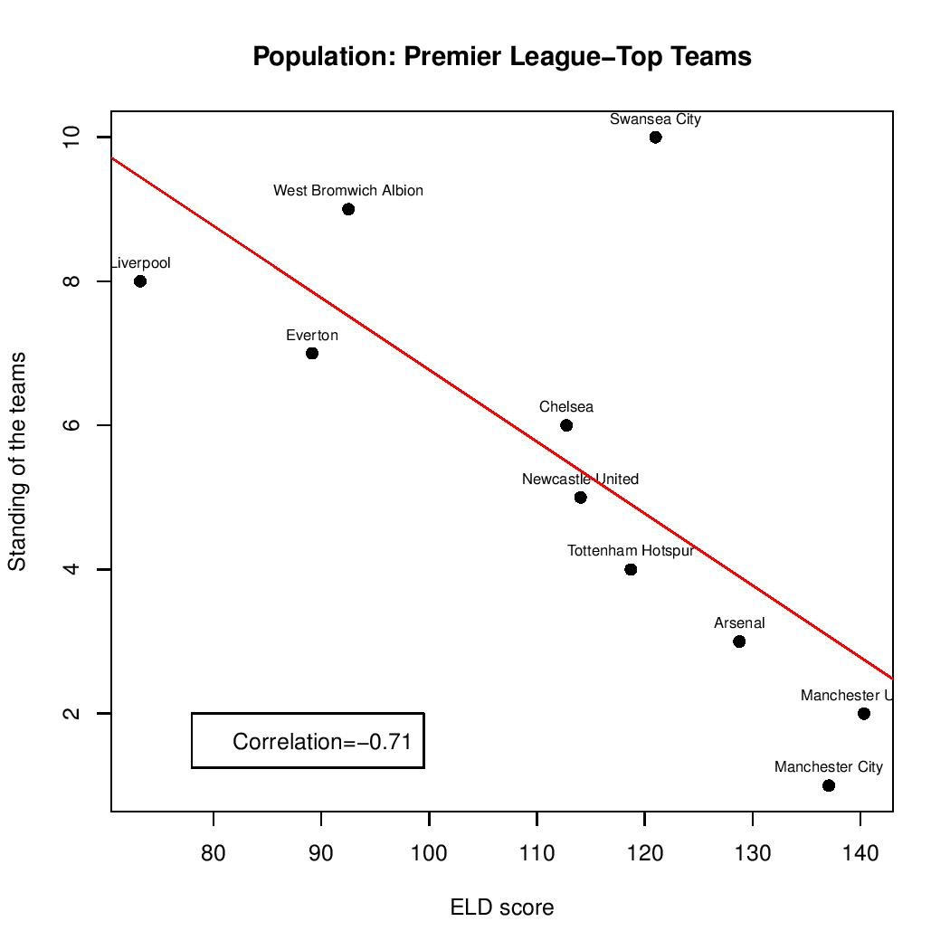
Correlation with Success
Teams and Ranking:
All teams and ranking => not a strong correlation
Top Teams and ranking => String correlation

Slide 41
Correlation with Success
Different group of players with Success metrics
Class | TimePlayed | Salary | SavesMade | ShotsOnTarget | PassEfficiency
Strikers | 0.76 | 0.79 | NA | 0.79 | NA
Midfielder | 0.73 | 0.45 | NA | NA | 0.89
Goalies | 0.69 | NA | 0.71 | NA | NA
All | 0.81 | 0.56 | NA | NA | NA

Slide 42
Why Midfielders have lower Correlation?
Stephane Sessegnon
Steven Gerrard (a famous player)
Name | Team | Salary Ranking | ELD Ranking | TimePlayed | Unsuccessful Passes | Successful Passes | Successful Corners
Gerrard | Liverpool | 2 | 21 | 1212 | 244 | 52 | 25
Sessegnon | Sunderland | 22 | 2 | 3133 | 231 | 82 | 15

Slide 43
Summary and Conclusion
ELD results in a meaningful ranking
ELD gives a higher score to both exceptionally good and exceptionally bad individual.
Future work: investigate how other metrics perform in the task of detecting in-class outliers and/or predicting success

Slide 44
Summary
Two Model-based outlier detection methods for relational data
First one based on propositionalization
Second one based on difference between the feature distribution of an individual from the feature distribution of its class
Proposed a new divergence metrics, ELD
ELD correlates with success metrics to some degree

